Slide 1
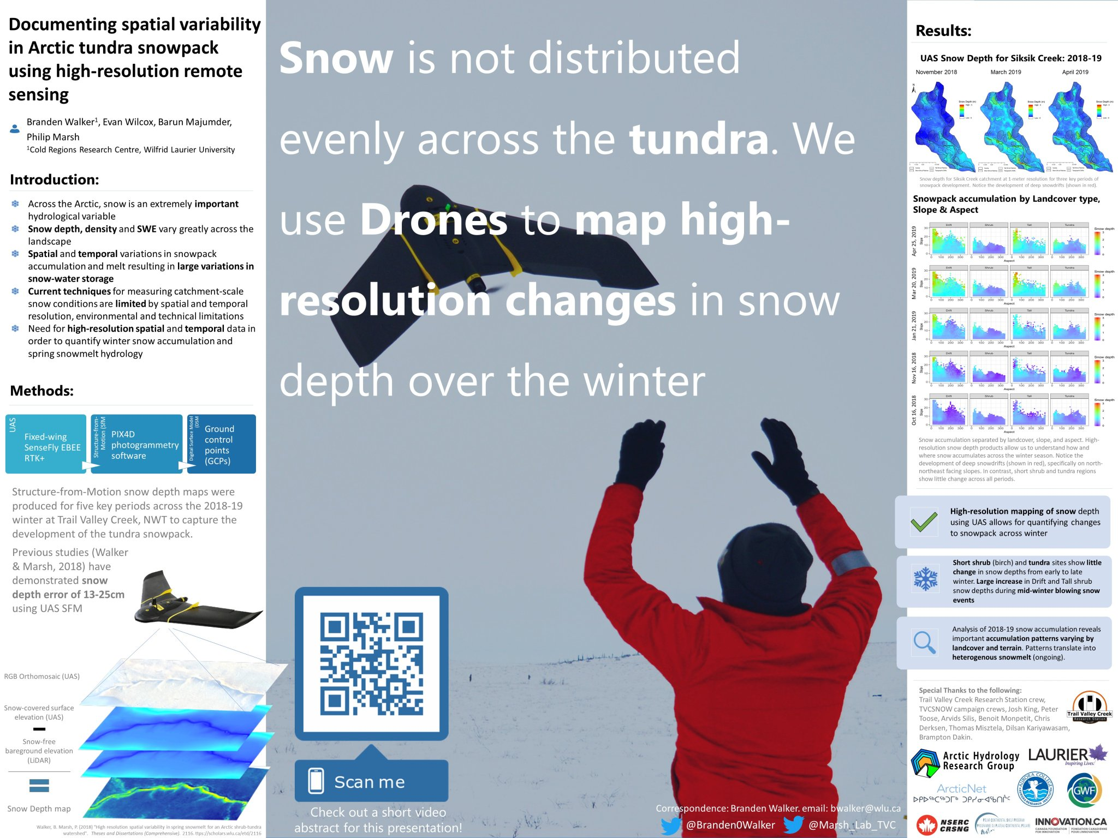
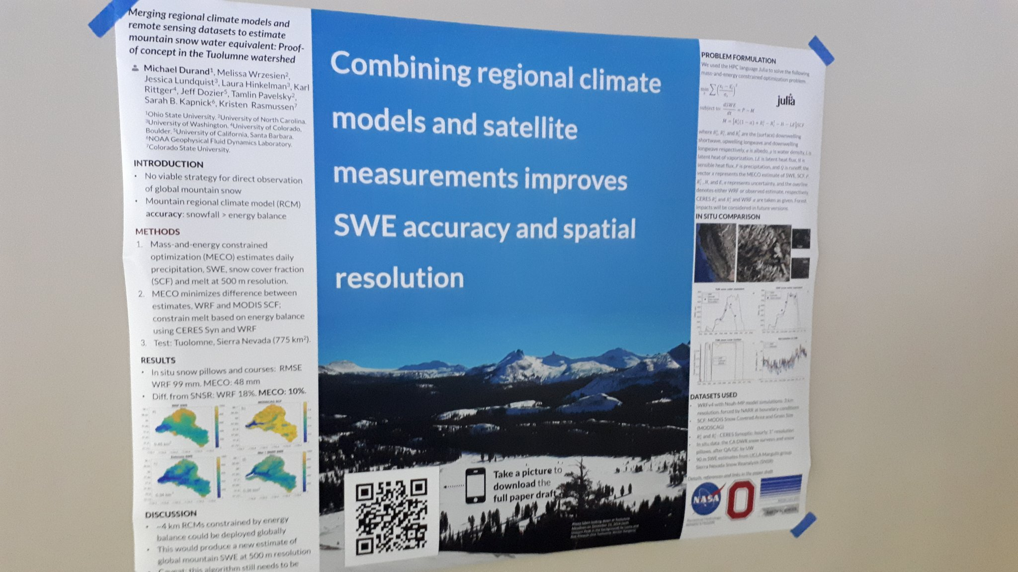
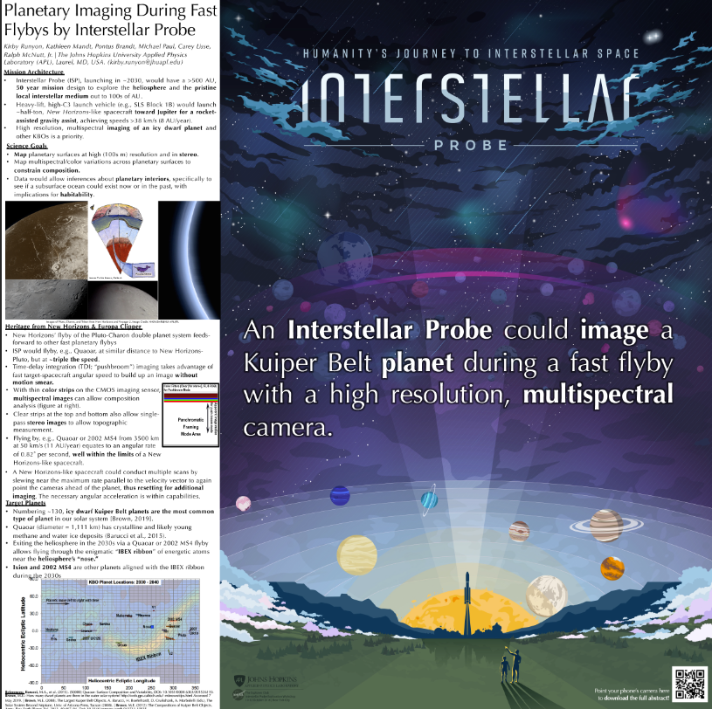
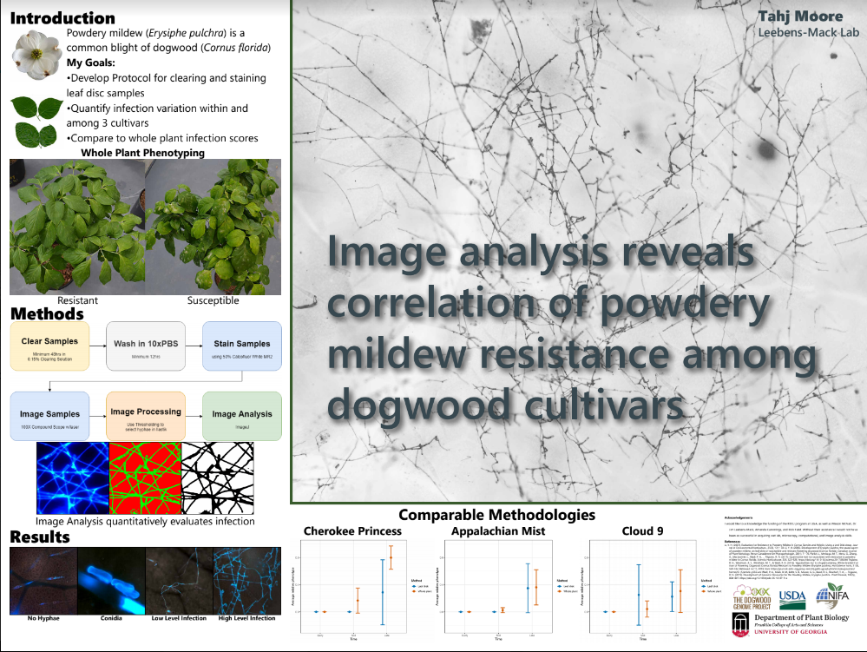
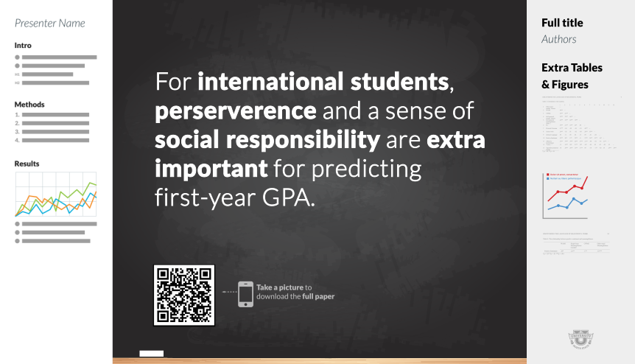

Try an on-theme background. Add fun and reinforce your study’s context, but make sure to keep a high contrast between your text and background!
Example donated by @brenden0walker
Example donated by @hydrogawker
Mountain photo by @mnthydro
Example donated by @nasaman58
vvv
Example donated by @SarraceniaMason
Example donated by @americoamorim
Example by @mikemorrison

Slide 2
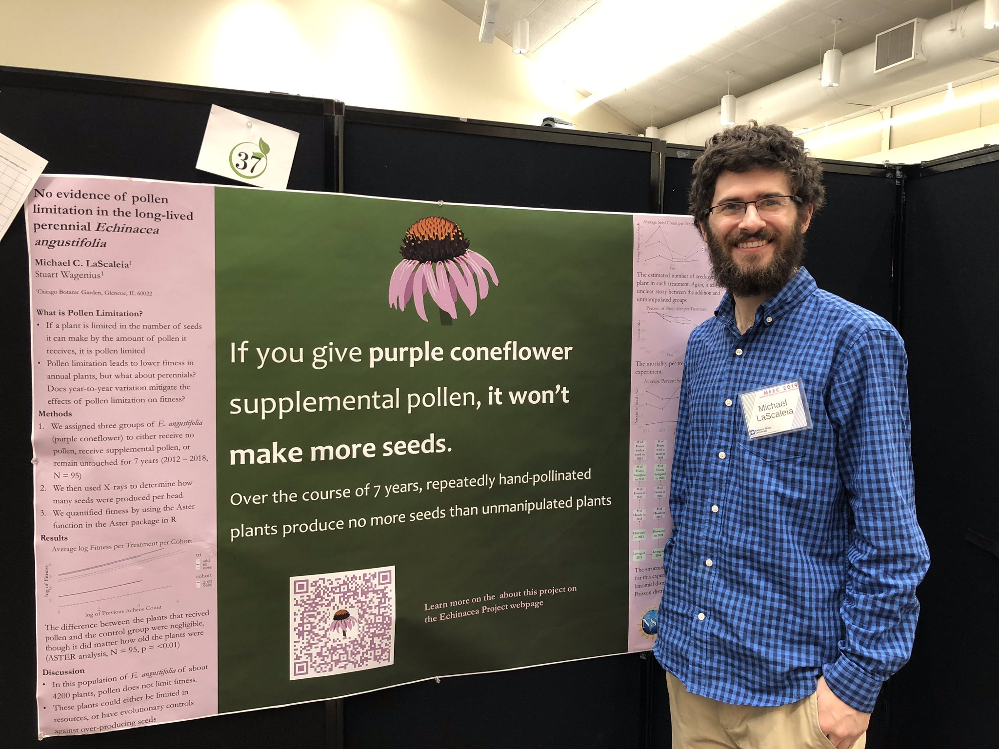
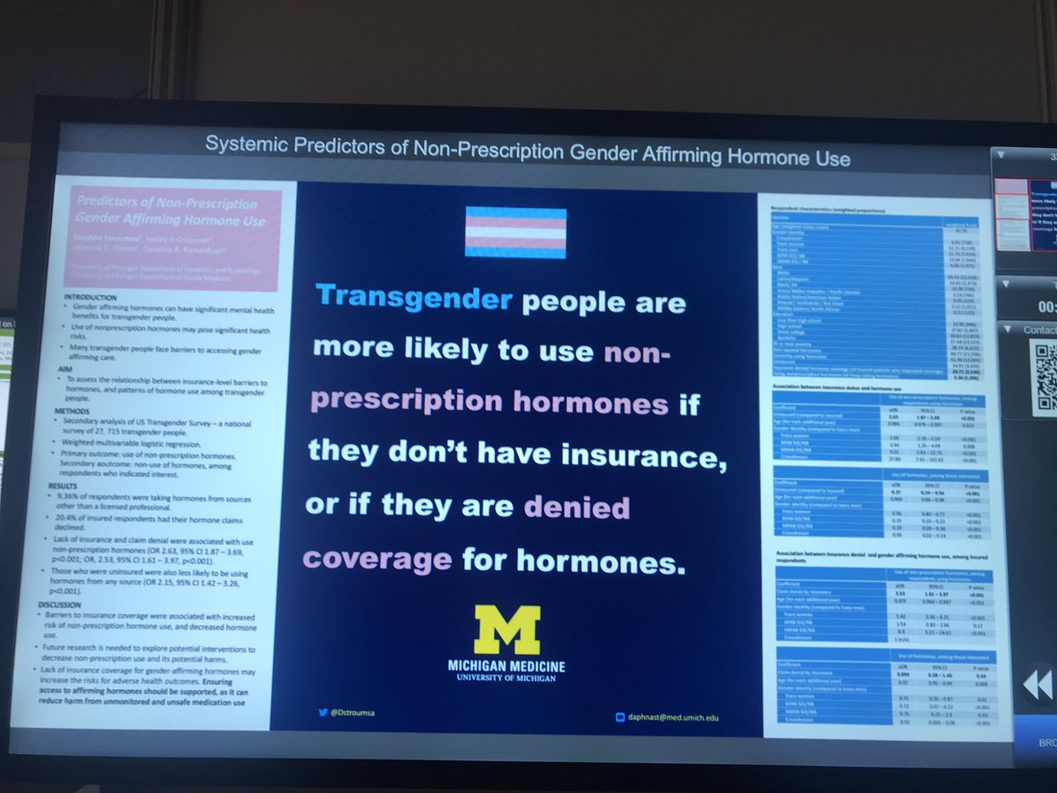
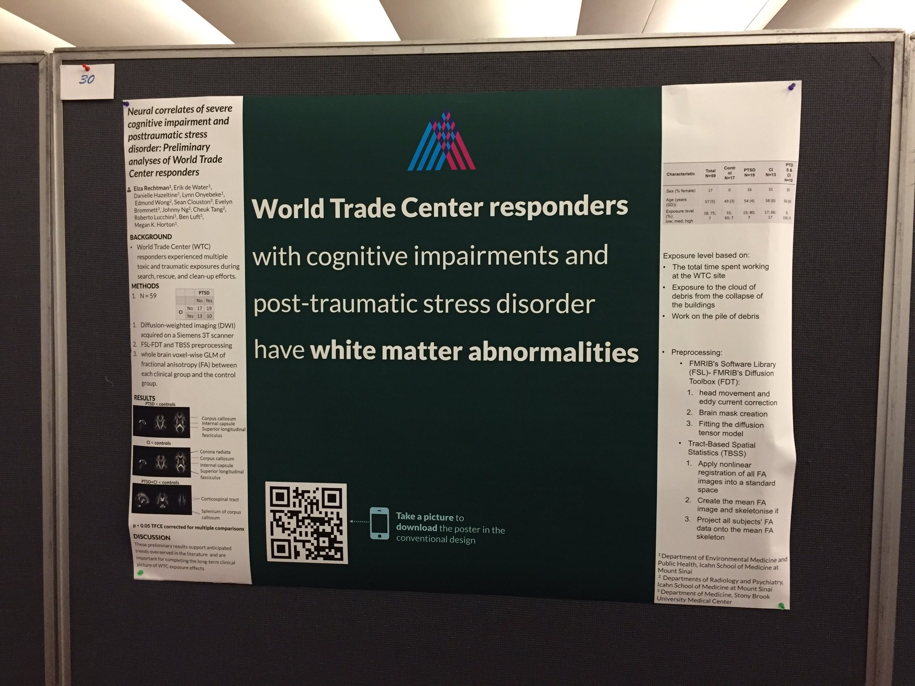
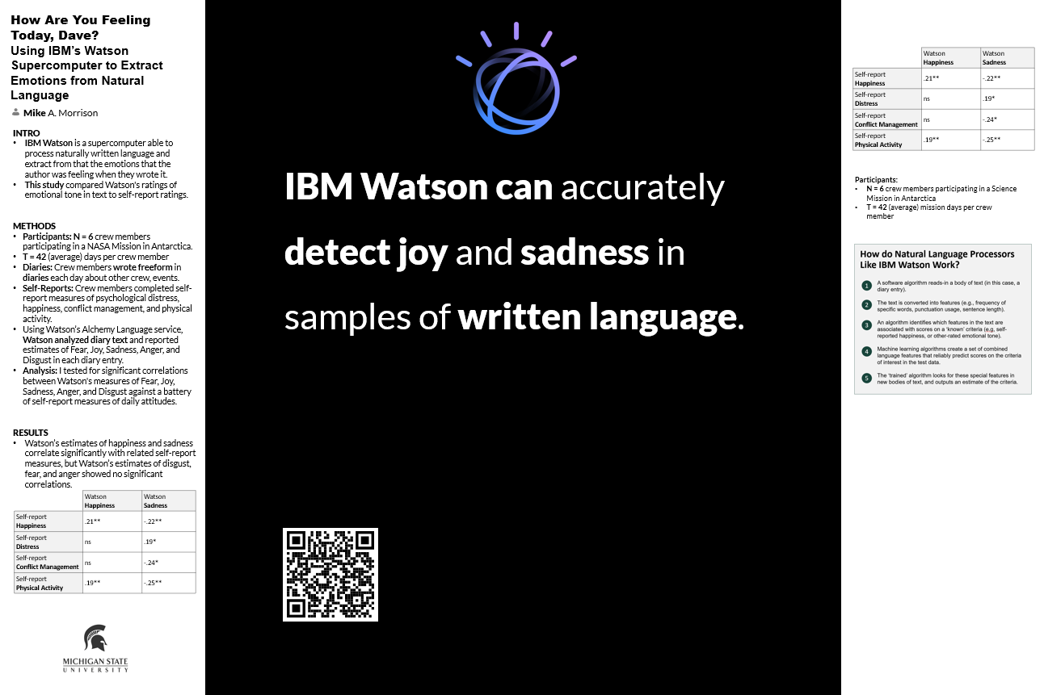
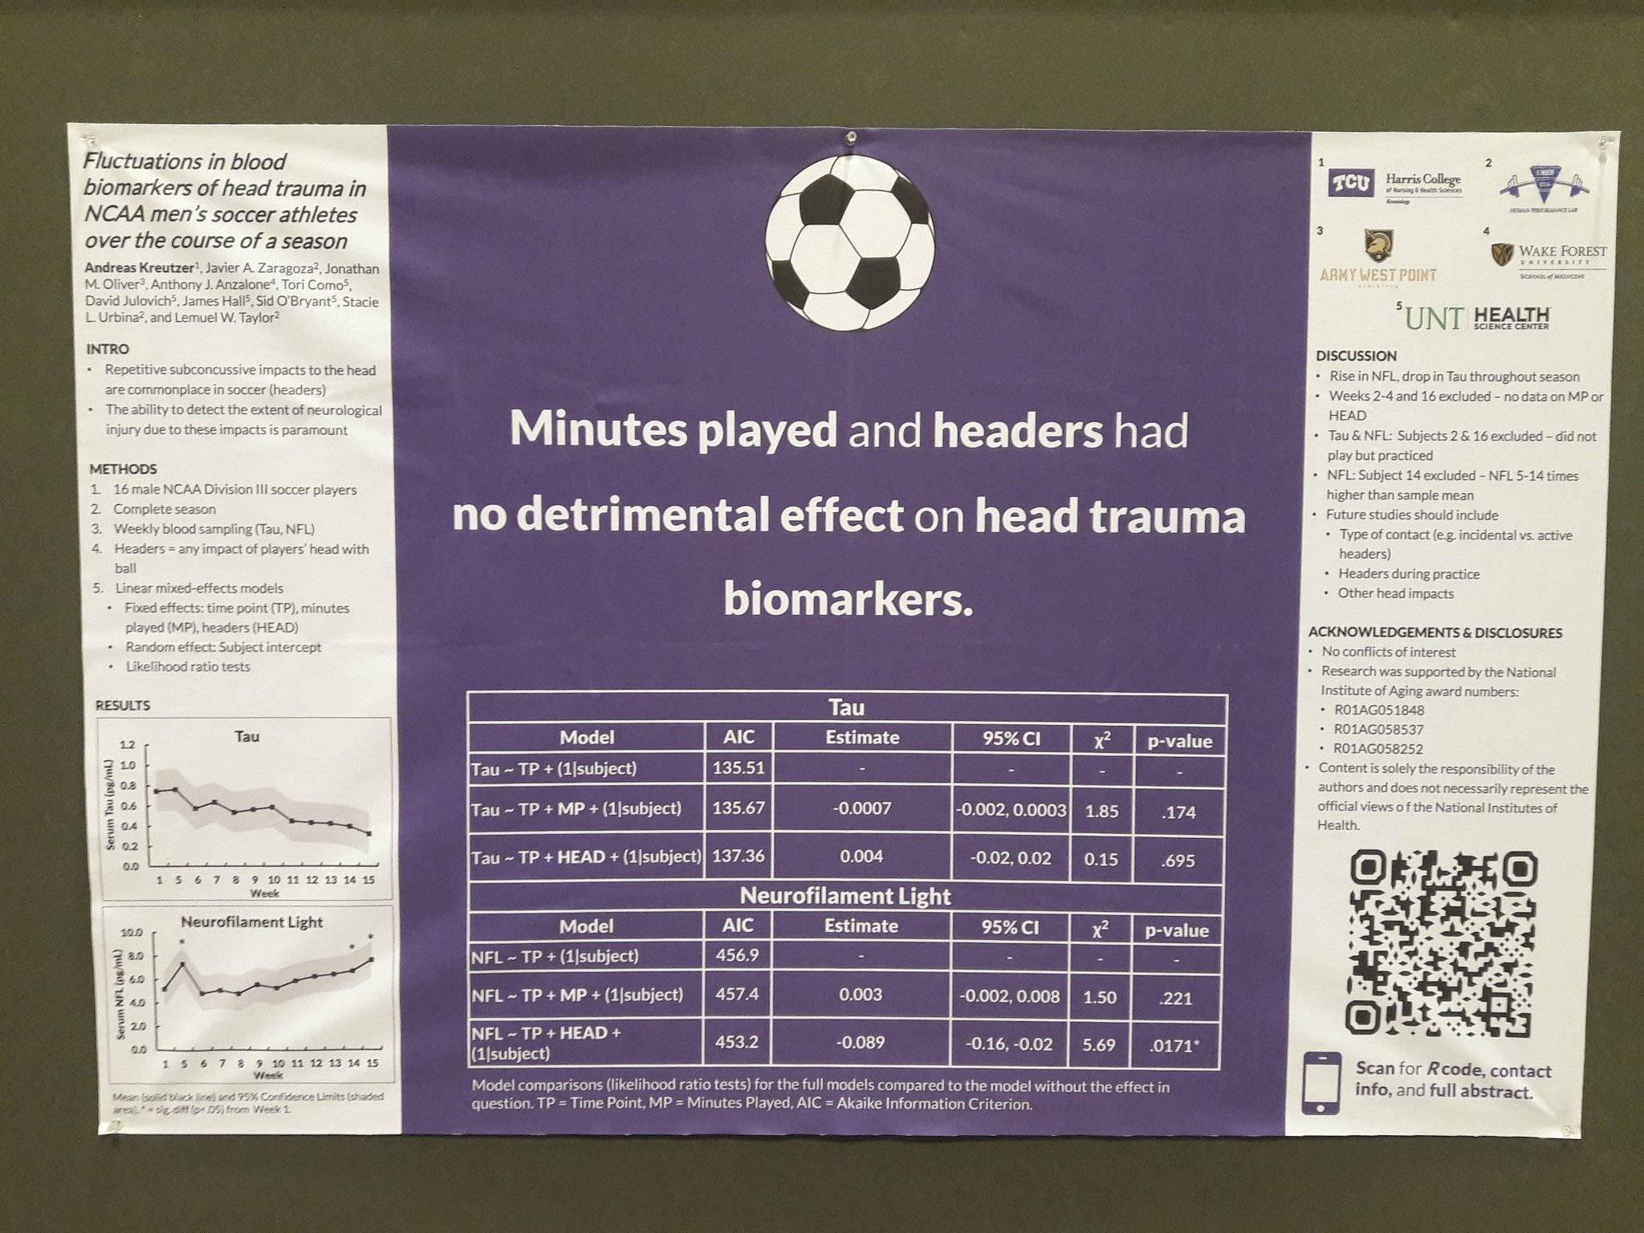
Try a ‘hat’ icon. Fun, reinforces your finding, makes your poster memorable — and can be interpreted at-a-glance.
Example donated by @MCLaScience
Example donated by @DStroumsa
Example donated by @ElzaRechtman
Example donated by @mikemorrison
Example donated by @akreutzer82

Slide 3
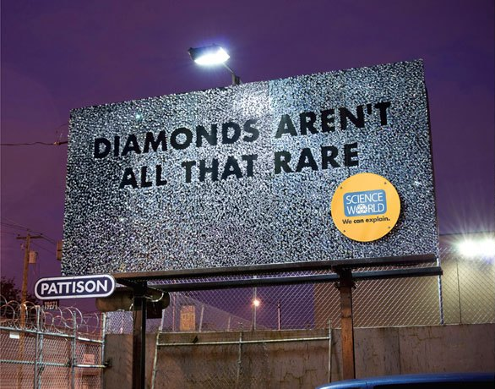
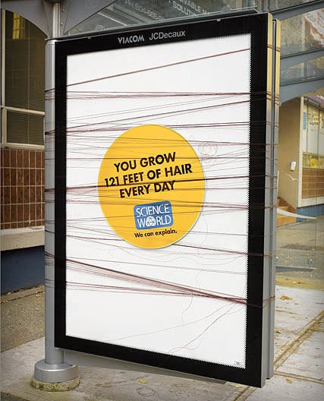
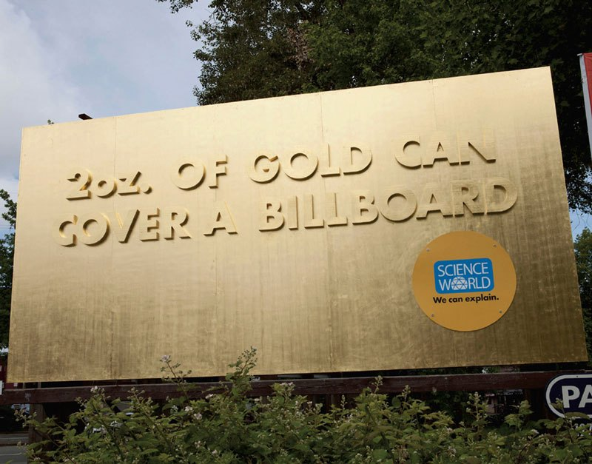
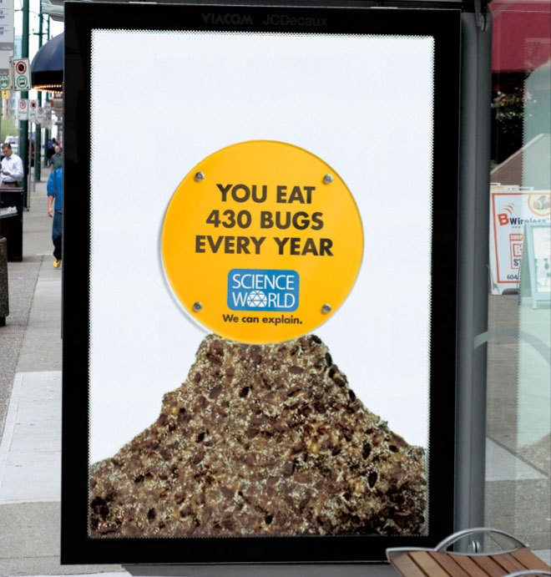
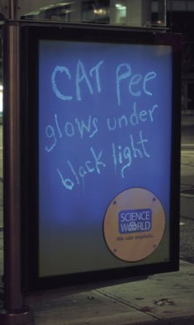
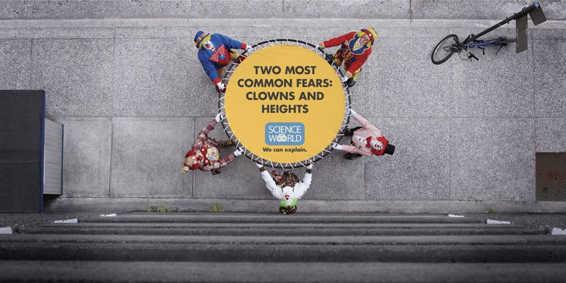
Here are some memorable science billboards for inspiration. Ctrl+Click here for more.

Slide 4
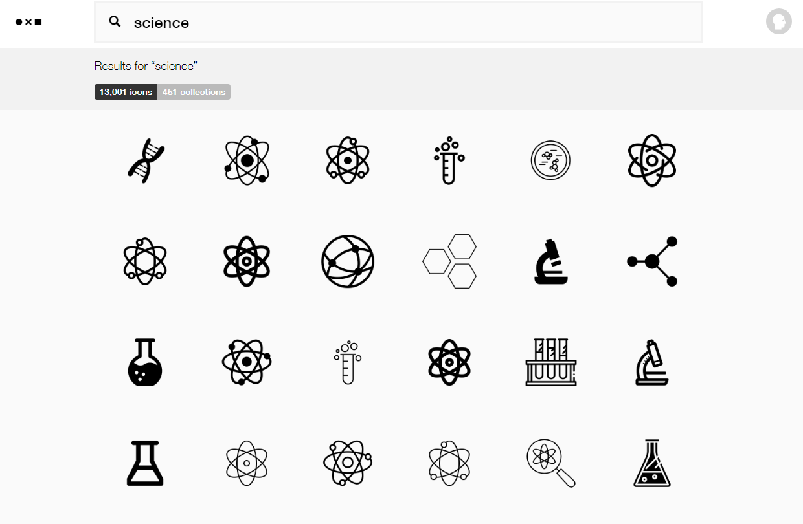
You can get free icons from TheNounProject.com
https://thenounproject.com

Slide 5
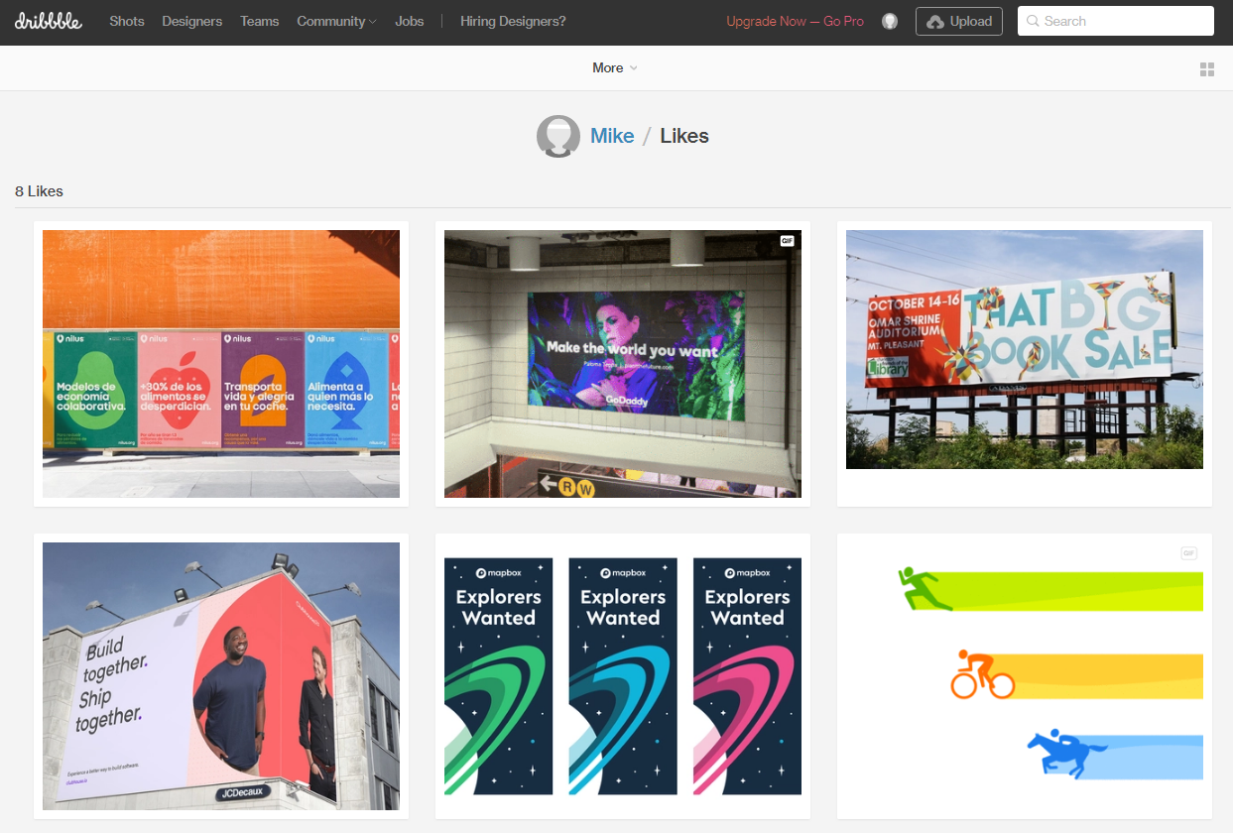
Stuck on a design dilemma? Do what other designers do! Go to dribbble.com and scroll through stuff until a solution jumps out at you. Try searching for “posters” or “graph”.
https://dribbble.com/

Slide 6
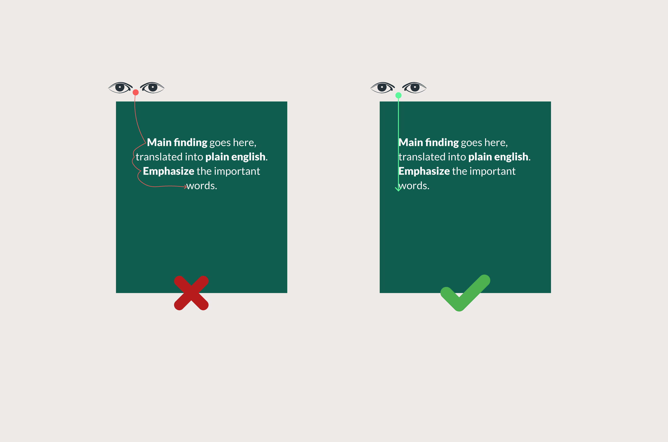
If your punchline is more than 2 lines, don’t center it. Centered text is slower to read than left-aligned text.

Slide 7
Gallery
Real posters designed based off of the main templates.

Slide 8
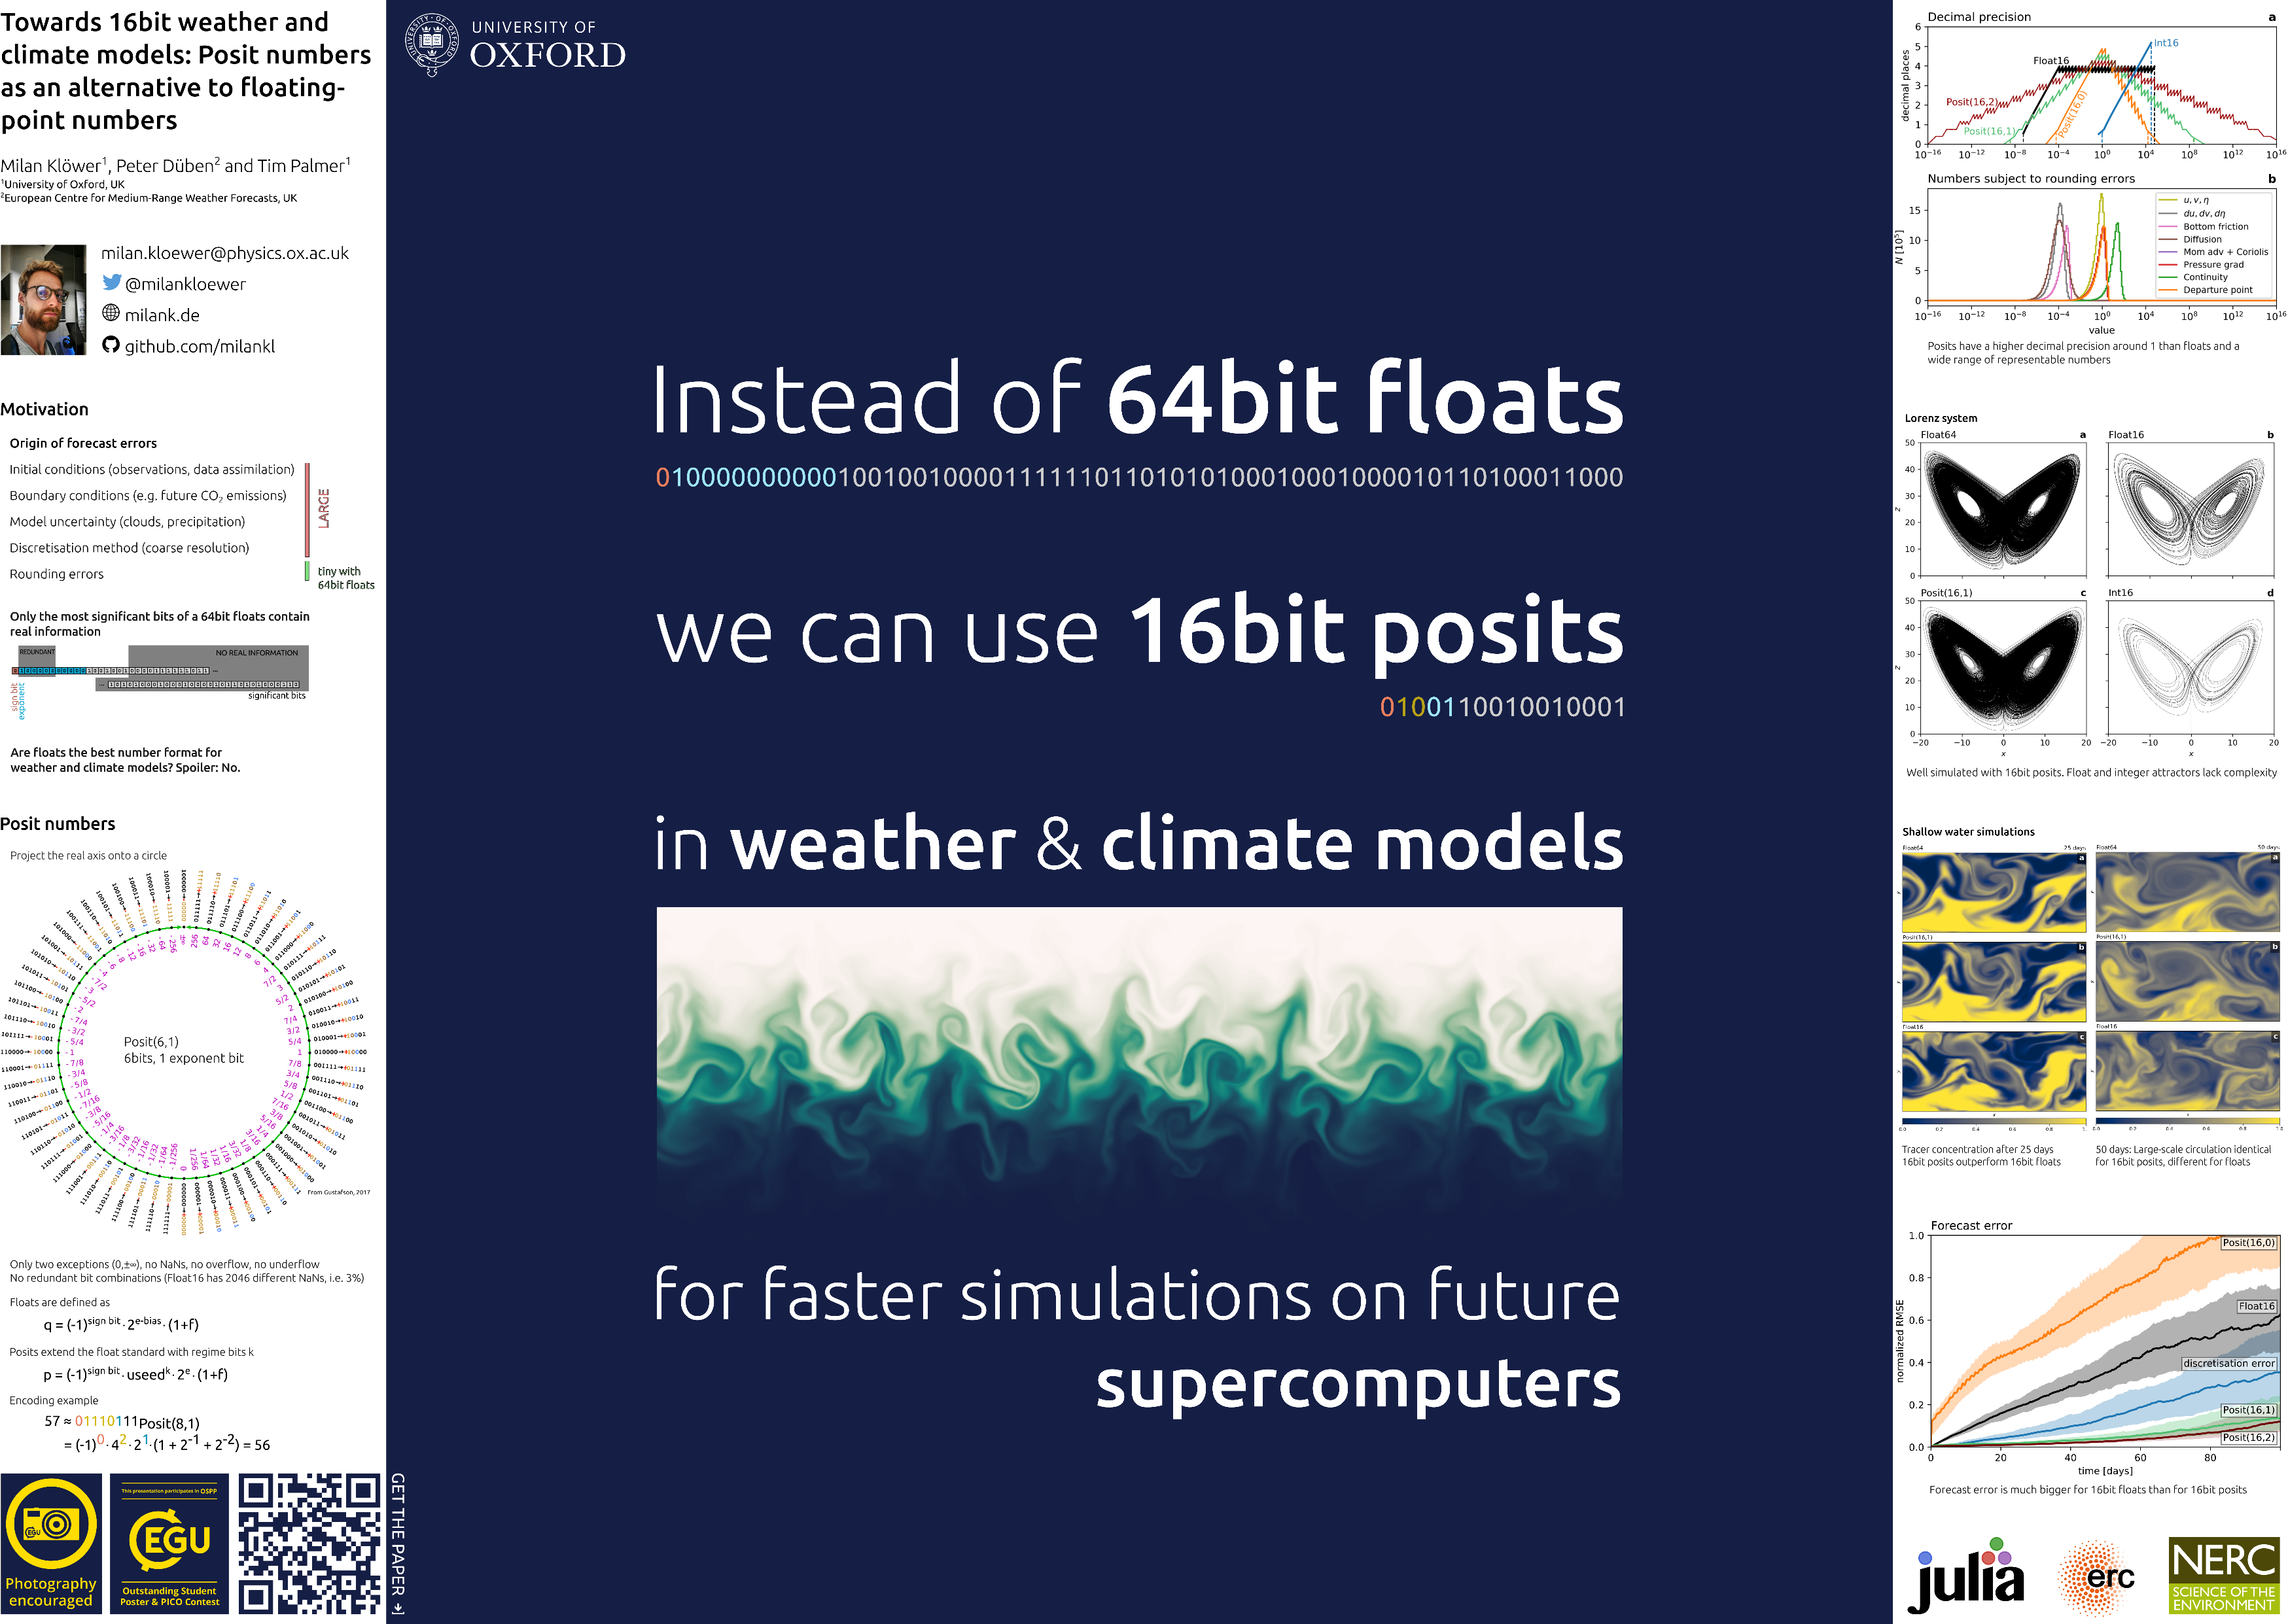
Example donated by @milankloewer
http://www.milank.de/documents/kloewer_egu.pdf

Slide 9
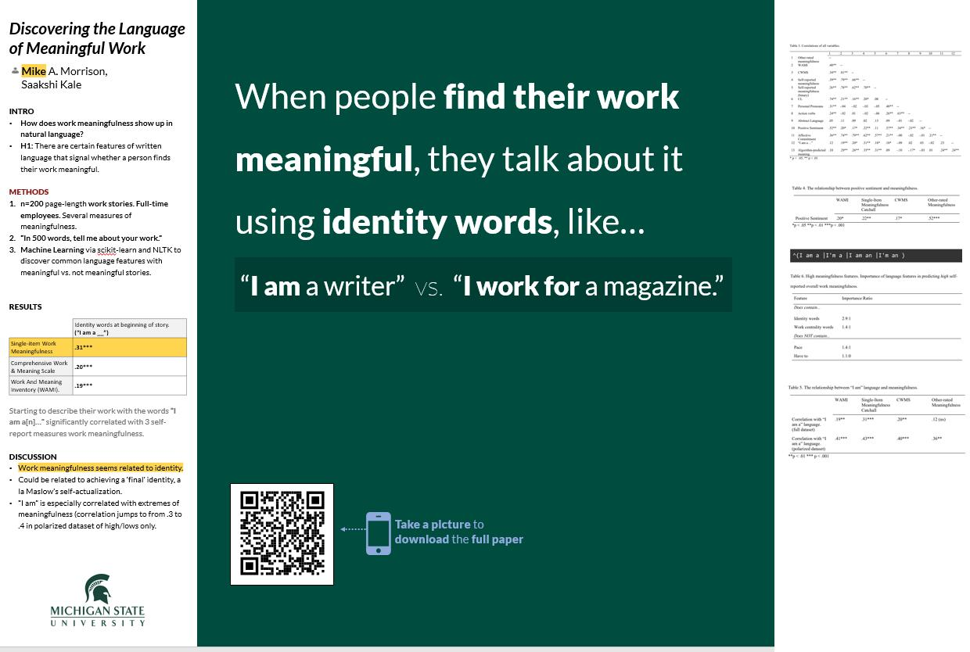
Example by @mikemorrison

Slide 10
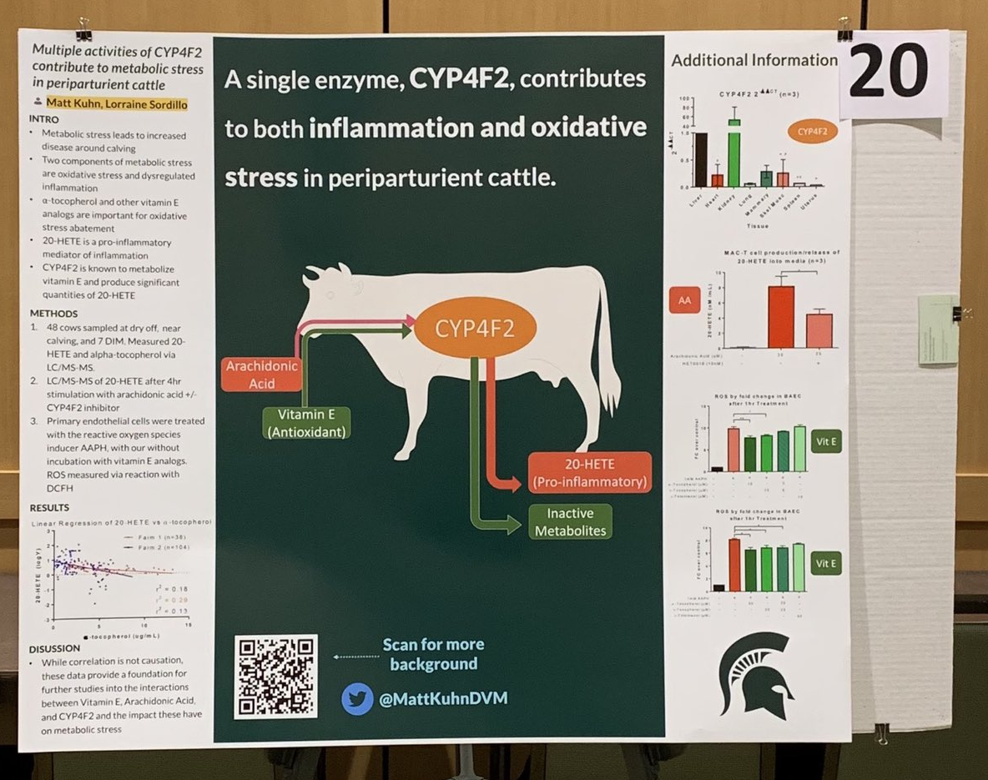
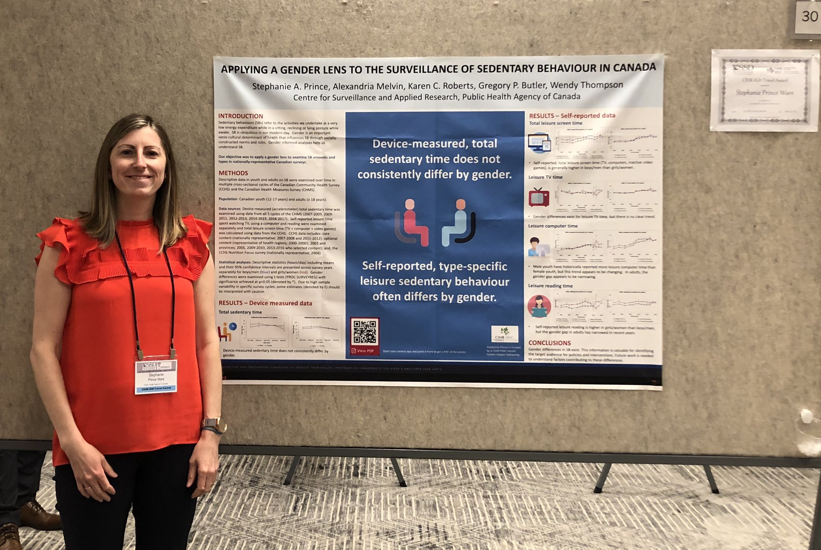
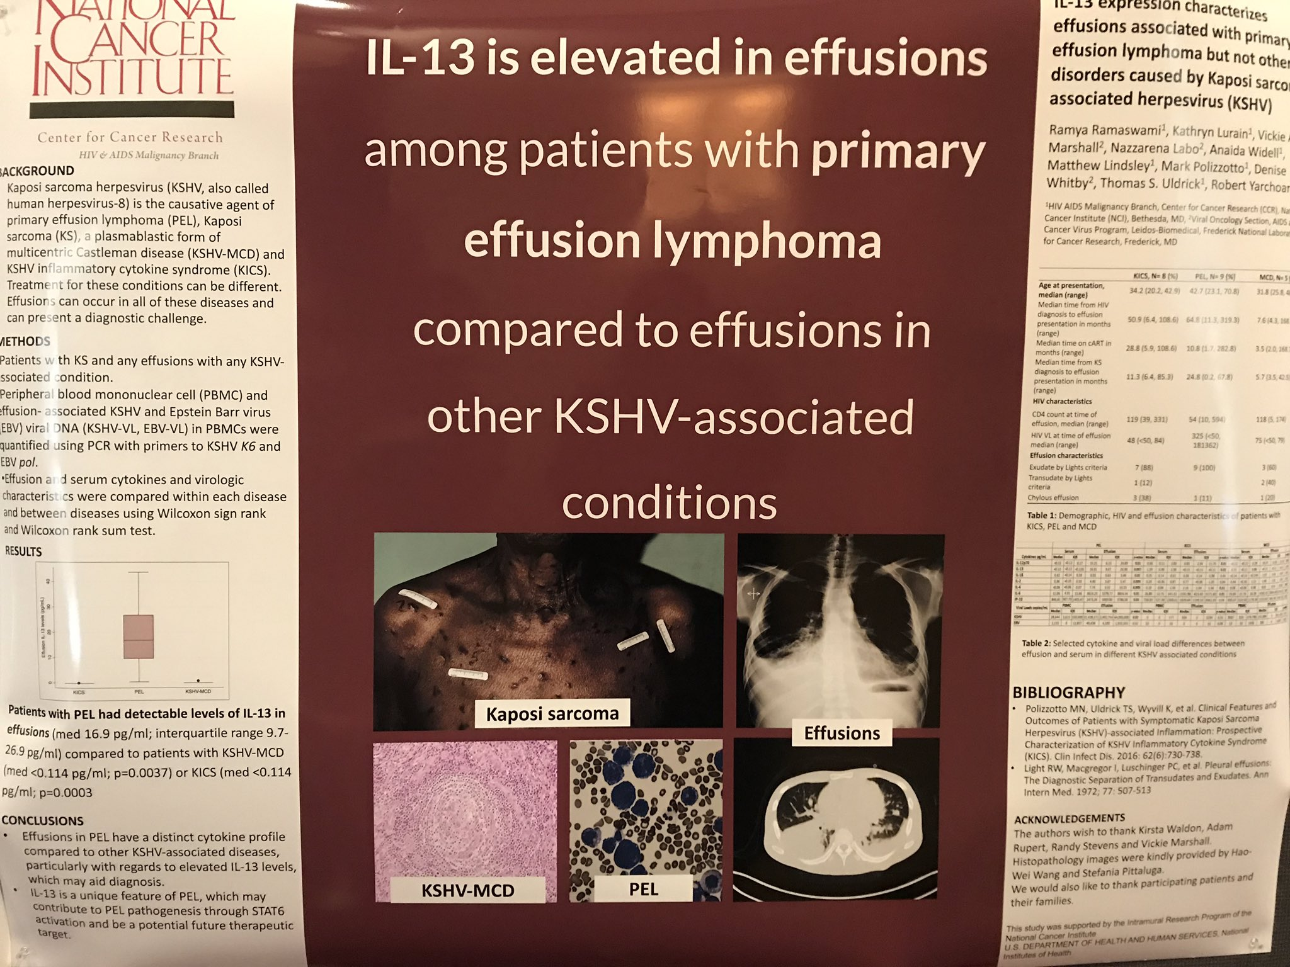
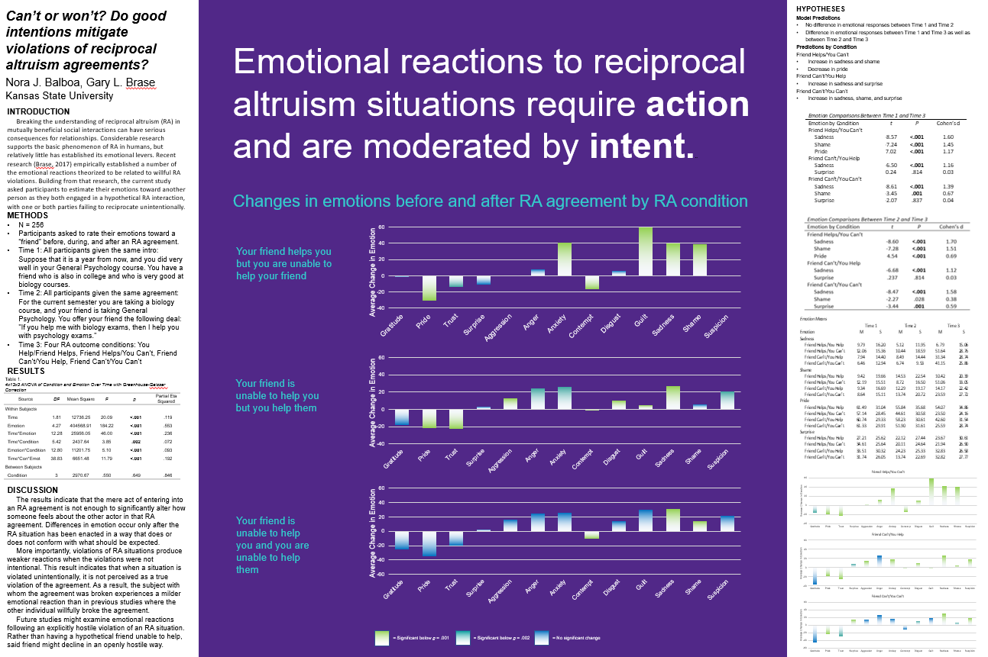
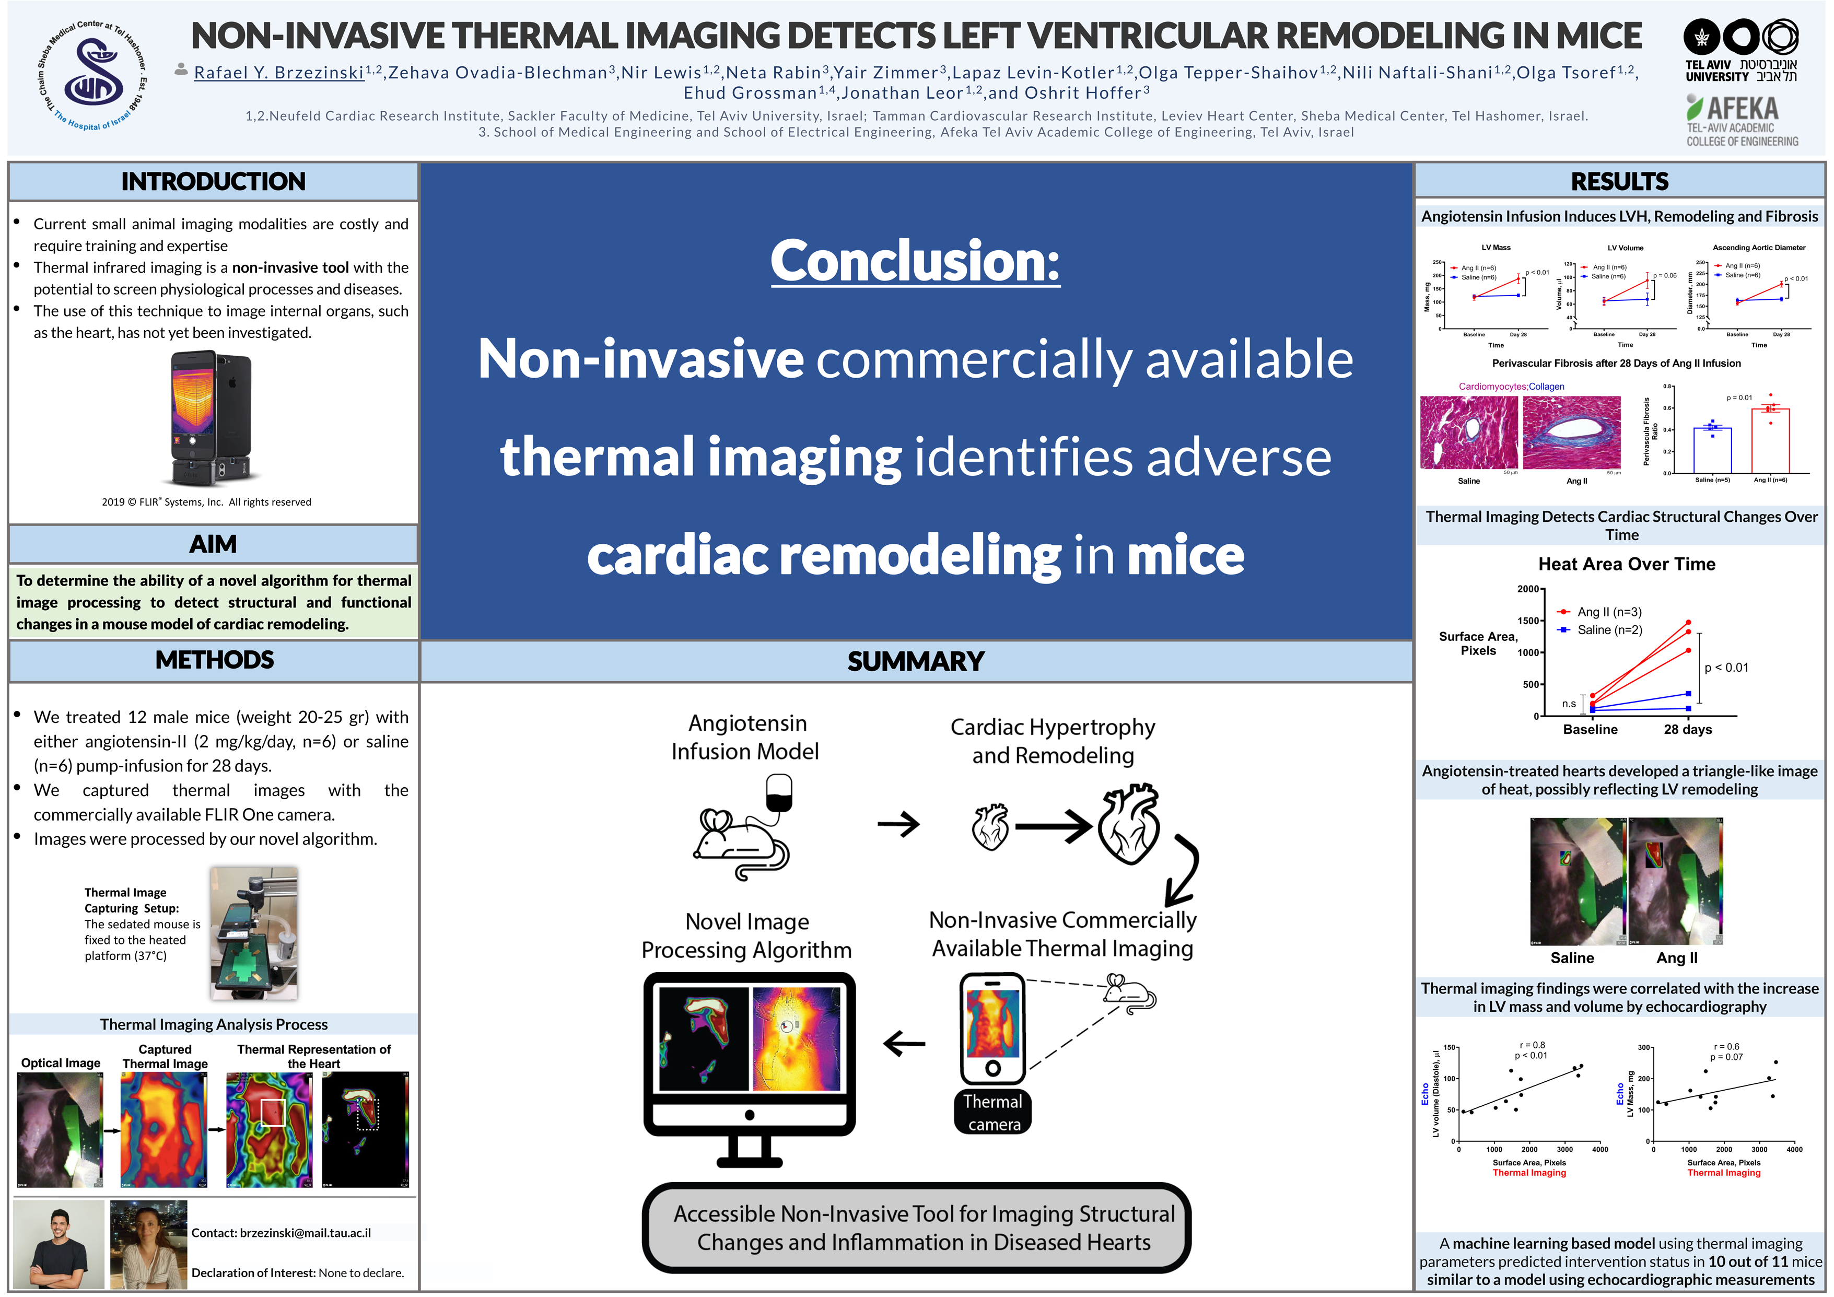
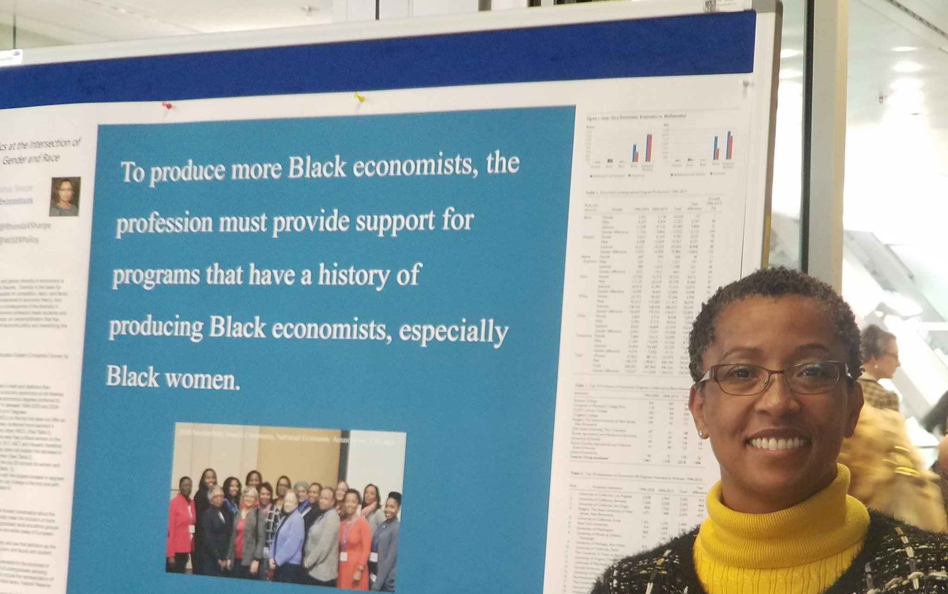
Example donated by @MattKuhnDVM
Example donated by @SPrinceWare
Example donated by @ramya_ramaswami
Example donated by @NoraBalboa
Example donated by @BrzezinskiRafi
Example donated by @RhondaVSharpe

Slide 11
Mods
Community-submitted modifications that you can edit.
Make them your own!

Slide 12
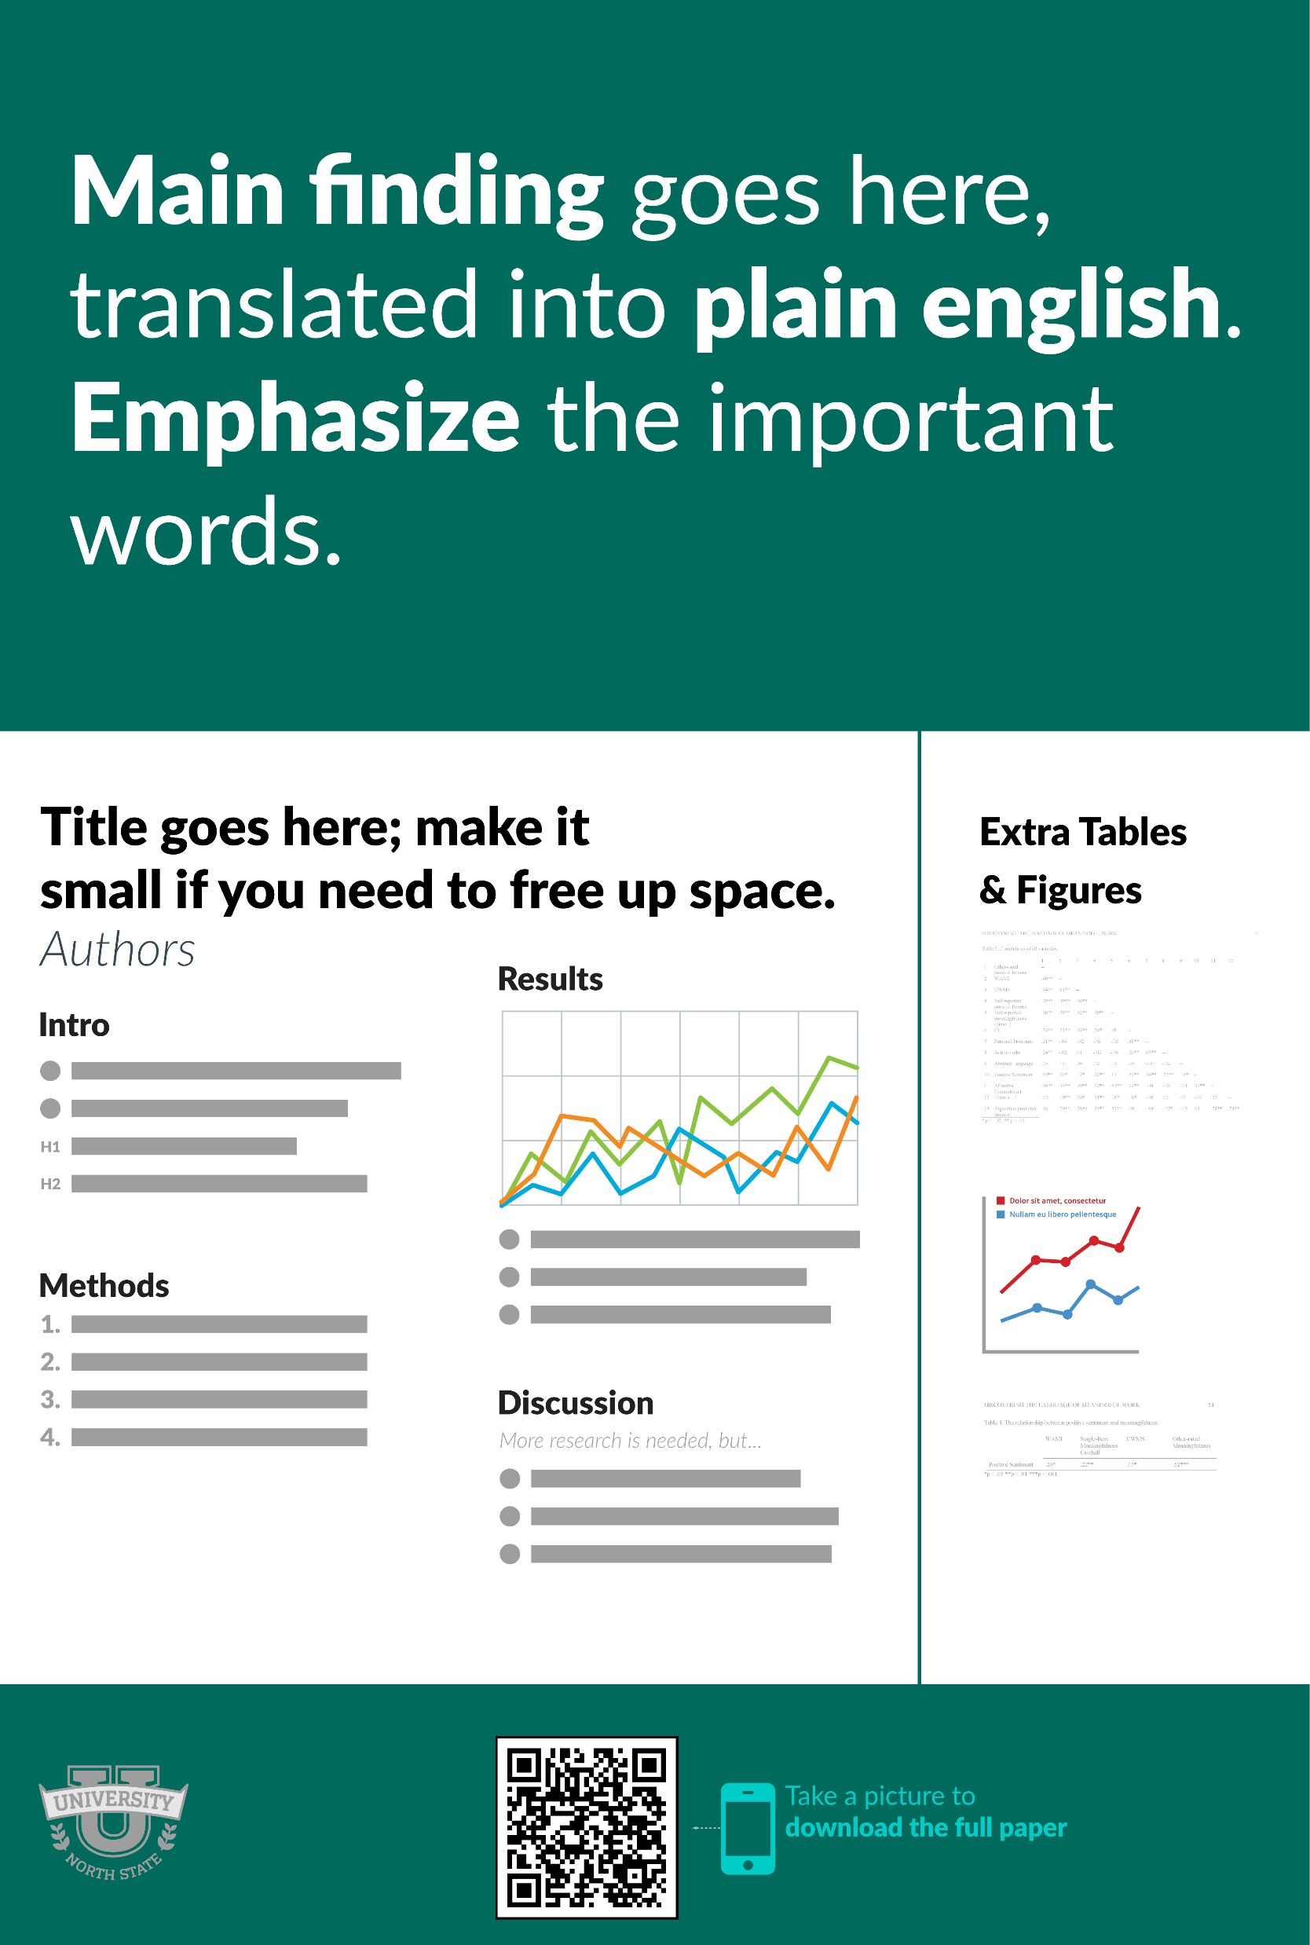
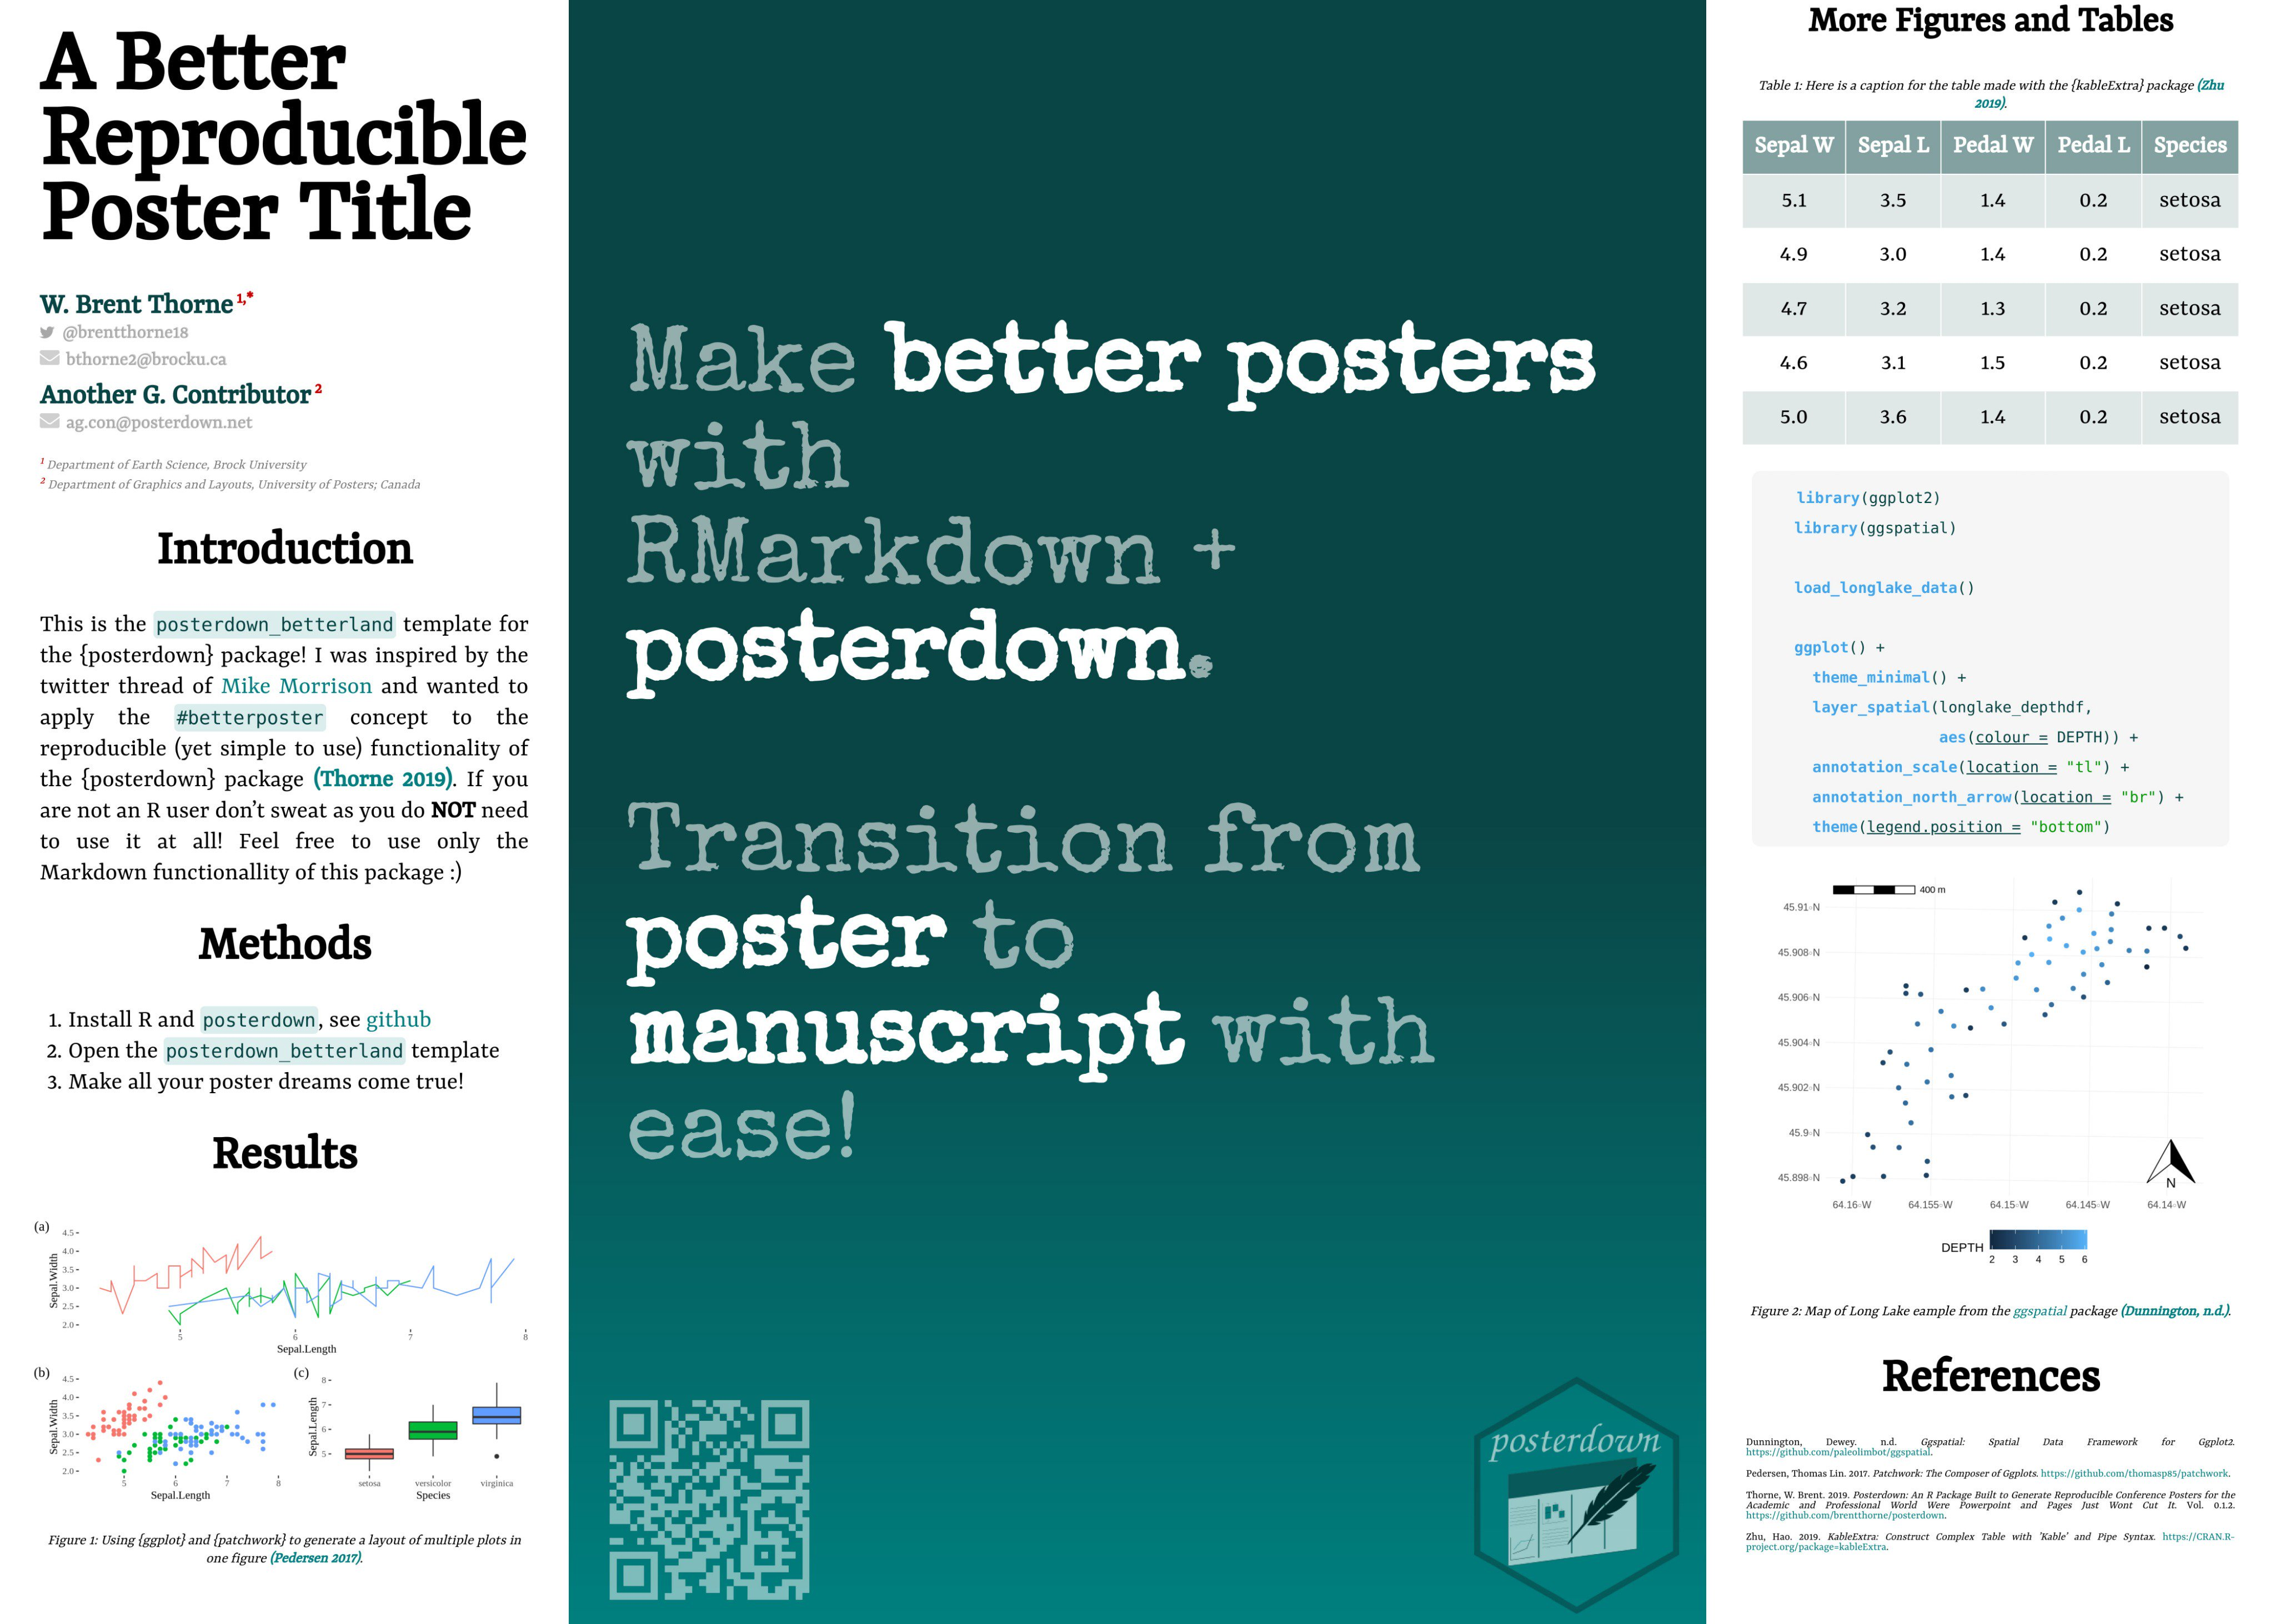

Portrait Orientation https://osf.io/g6xsm/
R/Markdown Template https://t.co/UsW4crrPZO?amp=1
by @mikemorrison
by @brentthorne18
Reproducible (LIVE) HTML poster (e.g., moving GIFs if you're into that)
Printable to PDF
Supports google fonts
Click for full features list…

Slide 13

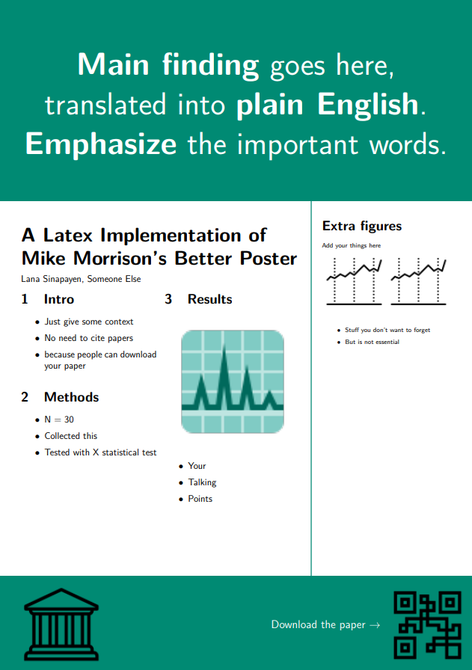
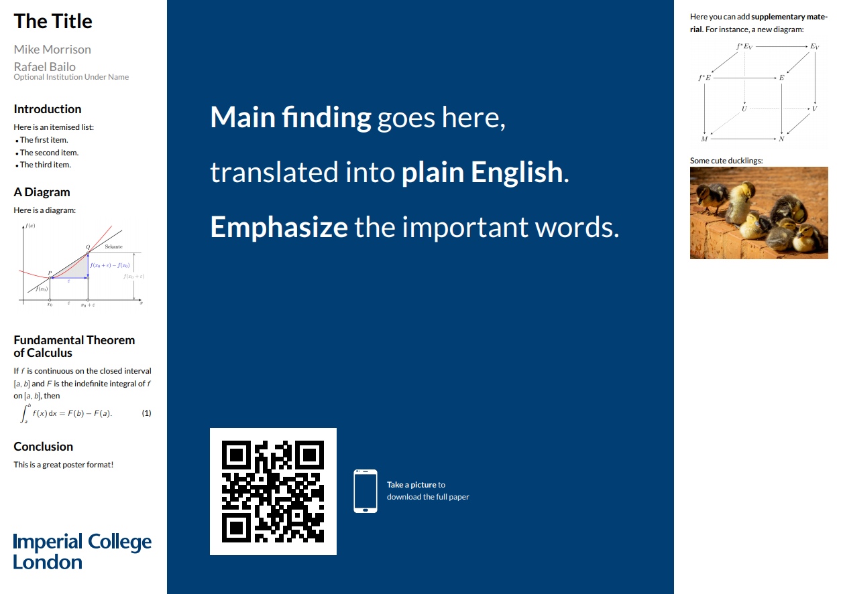
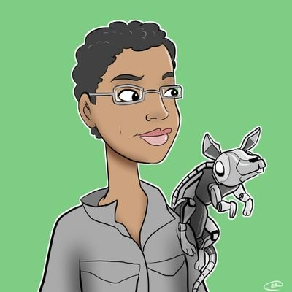


Templates
Portrait
Landscape
by @sina_lana
by @rtsbailo
Download (Ctrl/Cmd + Click)
Download (Ctrl/Cmd + Click)
https://github.com/LanaSina/better_poster_latex
https://www.overleaf.com/latex/templates/better-poster-latex-template/gmkgjvxqbyyt

Slide 14
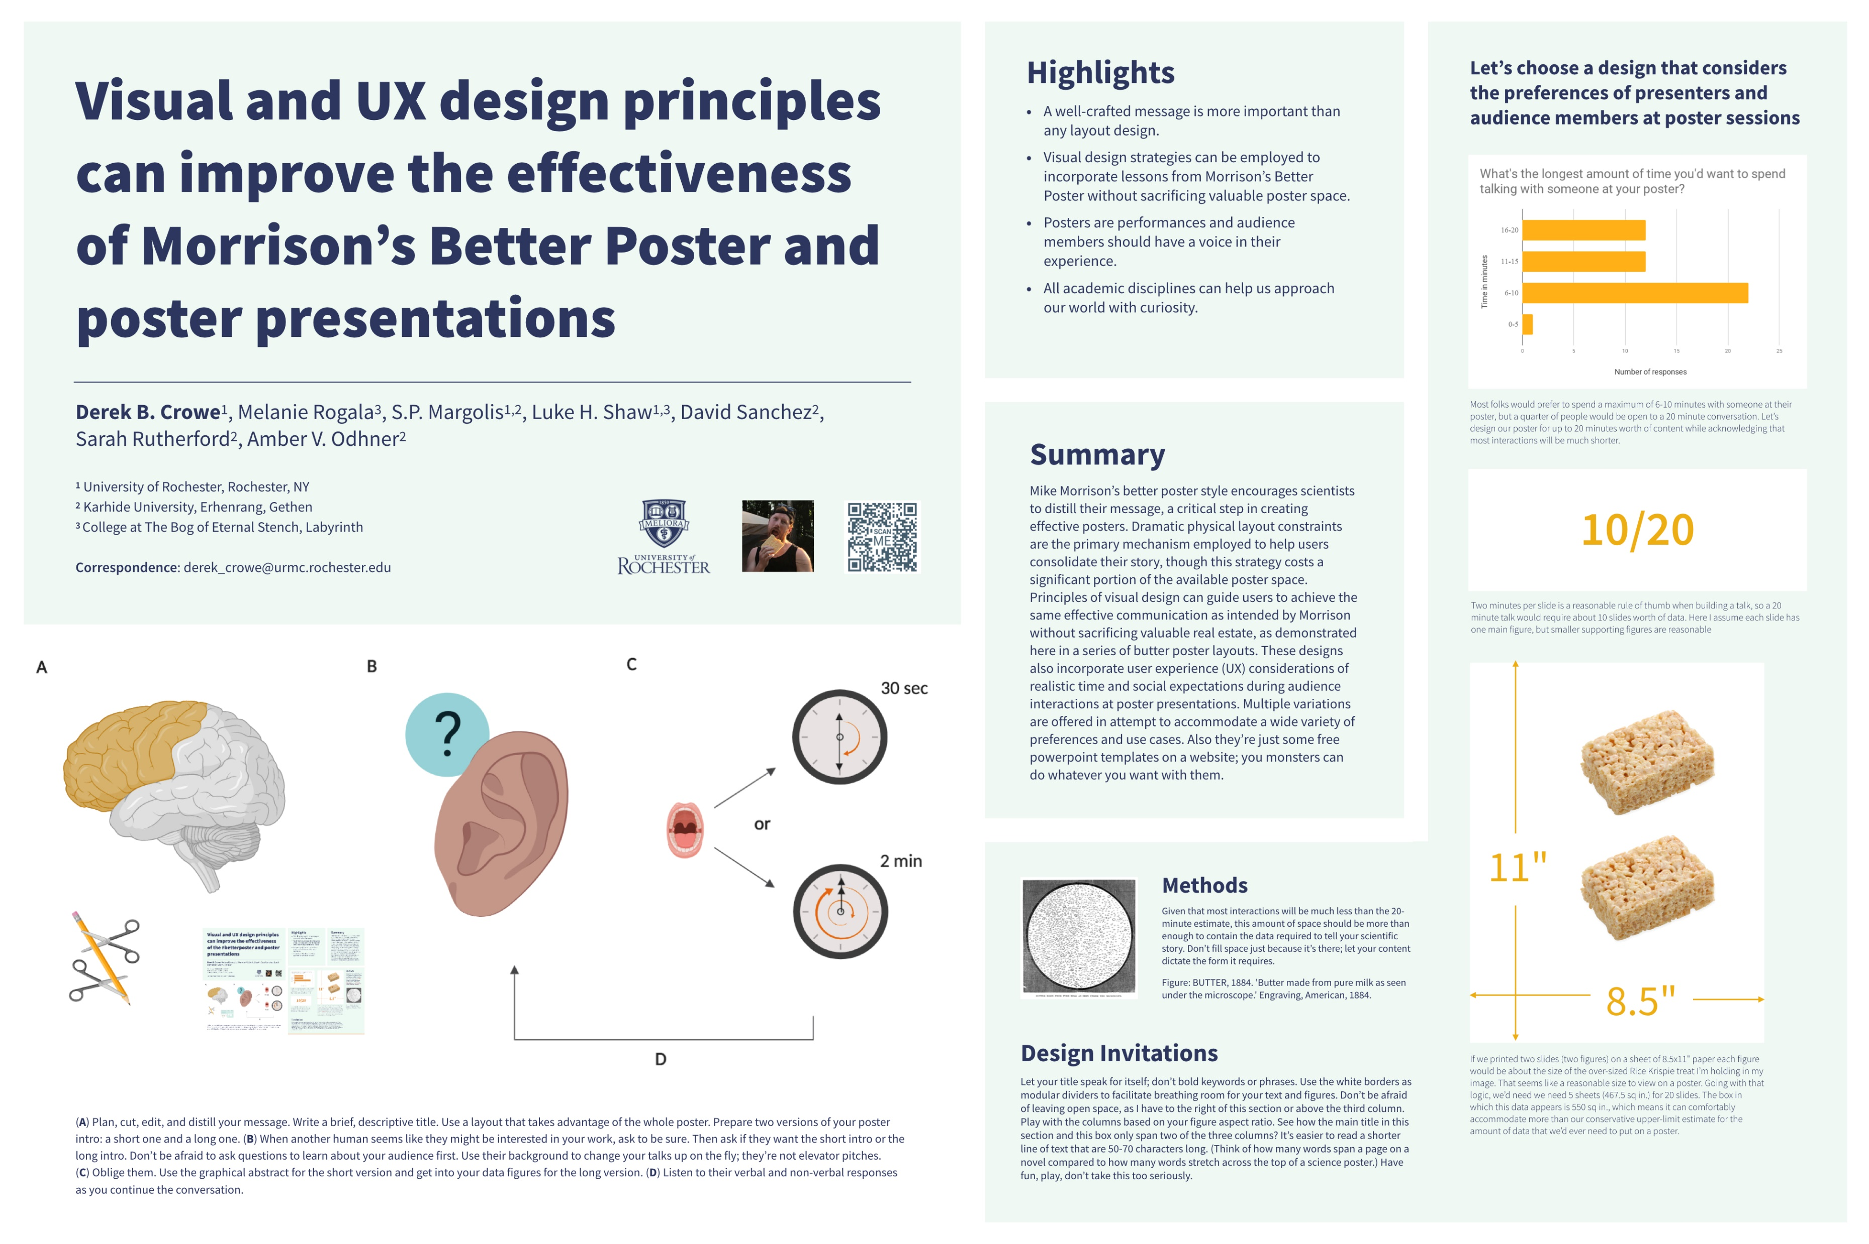
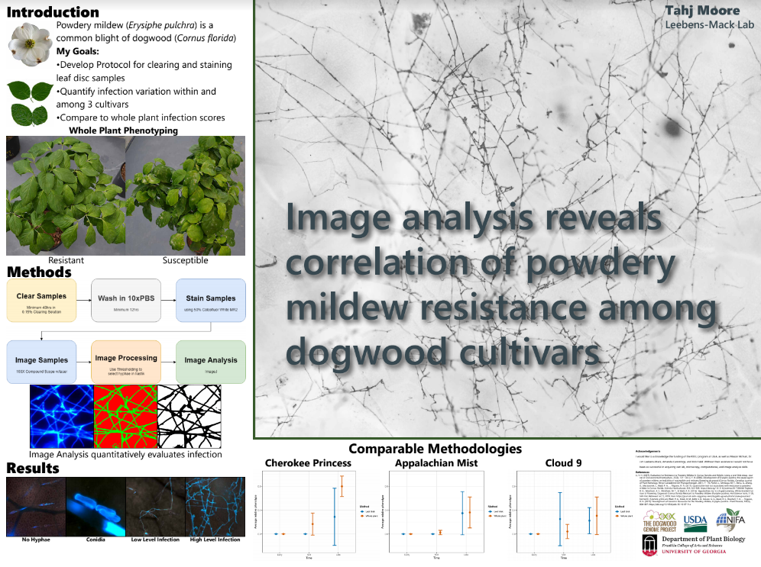
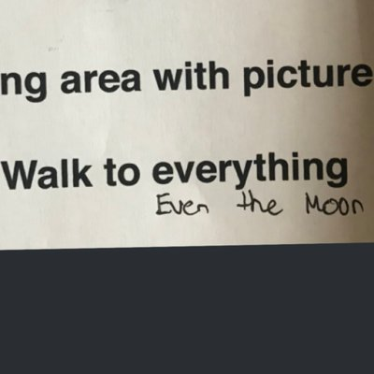

#butterposter
The “L” layout
by @derektoplasm
by @SarraceniaMason
Get templates from https://derekcrowe.net/butterposter
Adobe InDesign templates here: https://osf.io/zkmvw/

Slide 15
Research that influenced this design: a.k.a “I need some ammo to help persuade my faculty to try this.”
1. Need to know > Nice to know
https://www.nngroup.com/articles/inverted-pyramid
2. Plain language is interpreted faster.
https://www.nngroup.com/videos/plain-language-for-experts/
https://www.nngroup.com/articles/plain-language-experts/
3. Interaction cost.
https://www.nngroup.com/articles/interaction-cost-definition/
4. Effective designs minimize cognitive load
https://www.nngroup.com/articles/minimize-cognitive-load/

Slide 16
Layout F.A.Q.
What if my intro/methods/results doesn’t fit in the silent bar?
If you’re trying to put so much into that bar that it doesn’t fit, they won’t have time to read it anyway. First try moving stuff to the ammo bar. Next, cut cut cut.
Instead of trying to fill space, you’re trying to conserve space.
What if I have a really important graph or picture?
Move the QR Code to the Silent Presenter, then put your graph/image in the middle.

Slide 17
Design isn’t about making things look pretty. It’s about directing attention.
Great design is subtle. Design should feel like problem-solving.
UX designers feel a surge of happiness when they get to delete something.
When it looks too simple to represent the amount of time you put into it, you’re done.

